Slide 1

Subject Code
PT I - INTERDISCIPLINARY PROJECT
AI SUPPLY CHAIN MANAGEMENT
1. Sanjay J [ Reg.No. : 42611123 ]
2. Sarveswaran A [ Reg.No. : 42611127 ]
Internal Guide
Dr. R. Sathya Bama, M.E., Ph.D.,

Slide 2
PRESENTATION OUTLINE
COURSE CERTIFICATE
ABSTRACT
OBJECTIVES
SYSTEM ARCHITECTURE
HARWARE & SOFTWARE REQUIREMENTS
FRONT END DEVELOPMENT
BACK END DEVELOPMENT
RESULTS & DISCUSSIONS
RESULTS SNAPSHOTS
REFERENCES

Slide 3
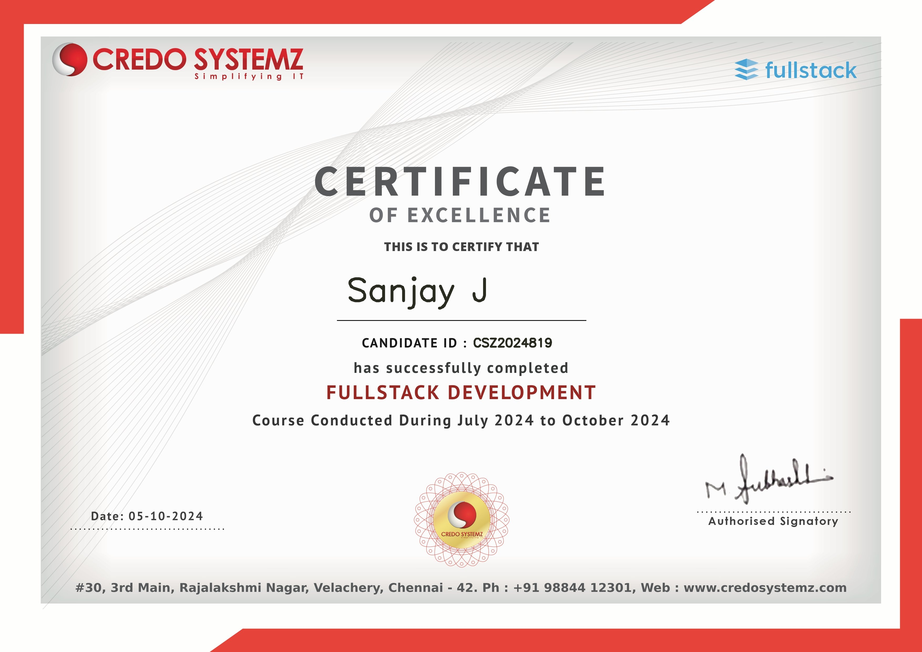
COURSE CERTIFICATE

Slide 4
ABSTRACT
In today’s dynamic and fast-paced business landscape, efficient Supply Chain Management (SCM) plays a vital role in maintaining competitiveness and meeting customer demands. This project presents an AI-powered SCM system that uses Deep Learning, specifically Long Short-Term Memory (LSTM) neural networks, to accurately forecast demand based on historical supply chain data. Built with TensorFlow, the model learns complex sequential patterns, enabling precise time-series predictions that enhance decision-making processes. Once trained, the model is deployed using a lightweight Flask backend, making the prediction service accessible through a user-friendly web interface. The frontend, developed using HTML and CSS, provides a clean and intuitive platform for users to interact with the system and view forecast results. This end-to-end solution ensures that powerful AI models are not only effective but also practical for real-world deployment. By integrating deep learning with modern web technologies, the system promotes data-driven strategies, smarter inventory planning, and reduced inefficiencies, ultimately transforming traditional supply chains into intelligent, adaptive systems for the future.

Slide 5
OBJECTIVES
The main objective of the project is to forecast product demand accurately using Long Short-Term Memory (LSTM) neural networks, enabling smarter inventory planning and restocking decisions in the supply chain.
To design and develop a user-friendly web application using Flask, allowing users to input product, shipping, and manufacturing data to receive real-time predictive restocking recommendations.
To minimize operational inefficiencies such as overstocking and stockouts, thereby reducing inventory holding costs and enhancing supply chain responsiveness.
To integrate AI-powered analytics with multiple supply chain parameters, including production costs, lead times, defect rates, and transportation modes, for comprehensive forecasting.
To build a modular and scalable system that supports future enhancements like multi-product forecasting and cloud-based deployment..

Slide 6
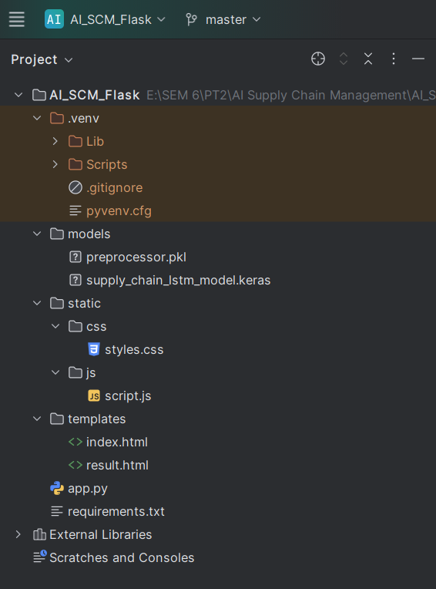
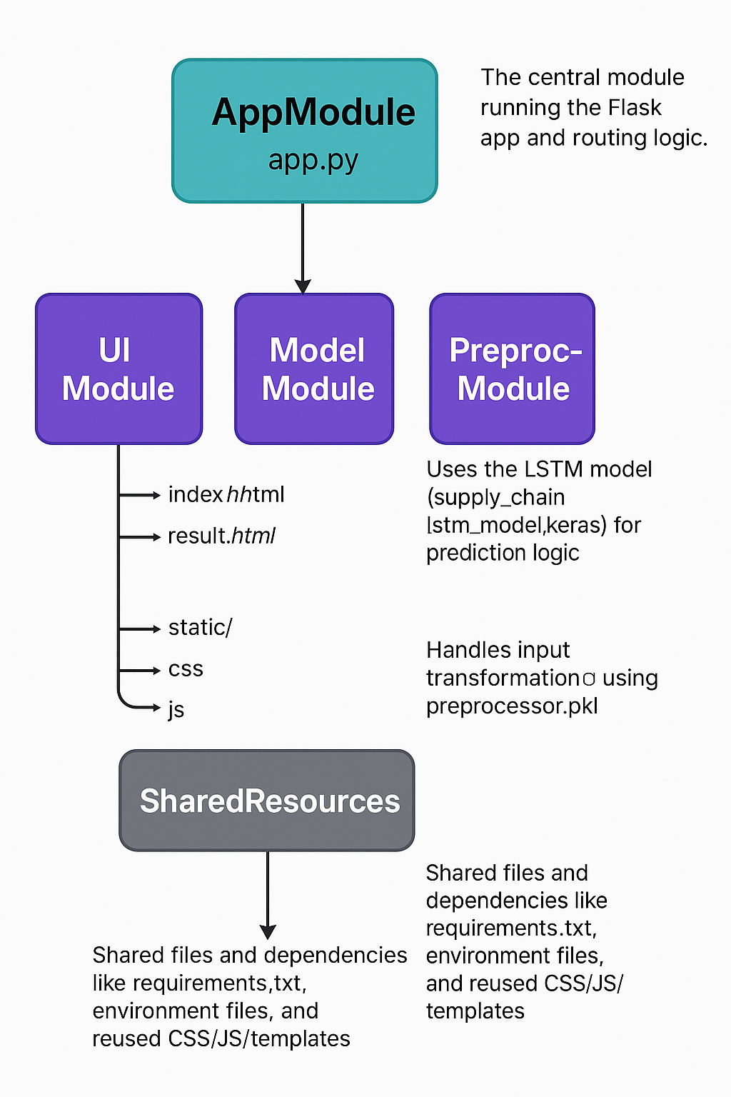
SYSTEM ARCHITECTURE

Slide 7
HARDWARE AND SOFTWARE REQUIREMENTS
Hardware Requirements
CPU: Multi-core processor (Intel Core i7/AMD Ryzen 7 or higher) .
GPU: 4-6 GB VRAM GPU
RAM: Minimum 8 GB, 16 GB Recommended
STORAGE: 256 GB SSD OR MORE
Software Requirements
PYTHON 3.8: Training & Backend Development
TENSORFLOW 2.X: Deep Leaning Library to train LSTM Model
Operating System: Windows, macOS, or Linux
FLASK: Lightweight Python Web Framework for creating Backend Api
JOBLIB: Saving and Loading the trained model and preprocessor pipeline

Slide 8
User Interface Components
Input Form (index.html): A structured form for users to enter supply chain parameters such as product type, stock levels, lead time, and shipping costs.
Result Page (result.html): Displays model predictions, restocking recommendations, transportation mode, and estimated total cost in a user-friendly layout.
Static Assets (CSS/JS): Enhance the appearance and responsiveness of the application, improving usability and cross-device compatibility.
Responsive Layout: The frontend layout is designed to adapt to multiple screen sizes for accessibility on desktops, tablets, and mobile devices.

Slide 9
Backend & Processing Components
app.py: Acts as the main controller, handling routing (/, /predict, /result) and coordinating between frontend, preprocessor, and model.
Prediction Engine: Loads the trained LSTM model (supply_chain_lstm_model.keras) to generate demand forecasts based on preprocessed inputs.
Preprocessing Module: Loads the serialized transformer (preprocessor.pkl) and applies scaling and encoding to match model input format.

Slide 10
AI Model Component
LSTM Model: A multivariate Long Short-Term Memory model built with TensorFlow/Keras to forecast product demand based on historical time-series data.
Model Evaluation: Performance metrics such as RMSE and MAE are used to validate prediction accuracy during development and testing phases.

Slide 11
Data Flow and Ingestion Layer
Joblib Integration: Preprocessor is saved using Joblib for consistent transformation during real-time user input.
Form-to-Model Pipeline: Captured data is validated and passed through preprocessing before being reshaped and submitted to the LSTM model for prediction
Input Validation Layer: Ensures all required fields are provided and correctly formatted before being processed, enhancing system reliability.
Output Rendering: Model predictions are sent back to the frontend and dynamically displayed on the result page.

Slide 12
Deployment and Environment Components
Virtual Environment: Isolates dependencies and packages required by the system.
requirements.txt: Lists all Python packages including Flask, TensorFlow, Pandas, and Scikit-learn.
Local Server Deployment: The application runs on localhost via Flask, with future scope for Docker or cloud deployment.

Slide 13
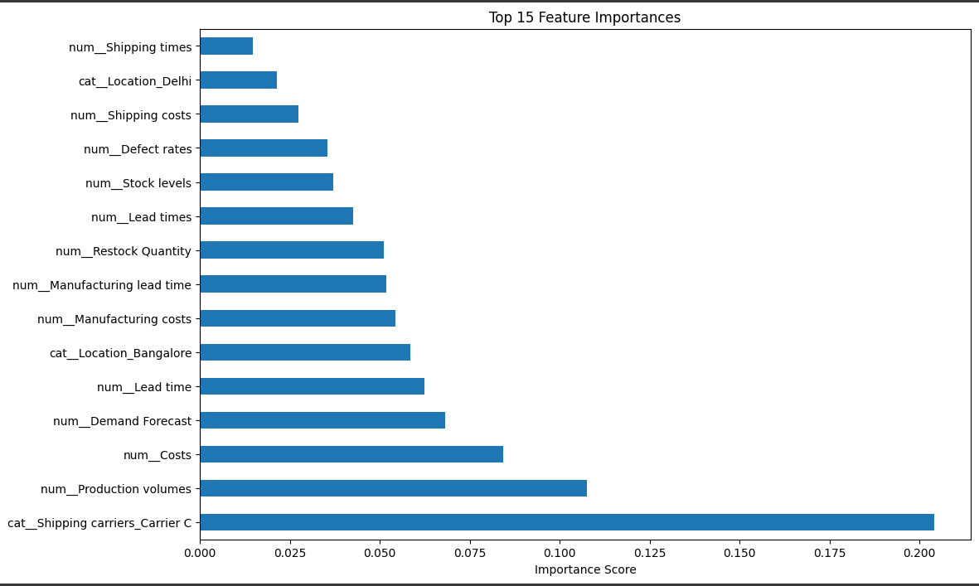
Monitoring and Feedback Loop
Error Handling and Logs: Flask handles exceptions and user errors with feedback messages rendered on the UI.
User Feedback: Results and predictions are monitored for accuracy, and user input helps inform model and UI refinement in future updates.

Slide 14
RESULTS AND DISCUSSION
The AI-based Supply Chain Management system was successfully implemented and tested using historical supply chain datasets containing variables such as stock levels, lead times, shipping costs, production volumes, and product categories.
The Long Short-Term Memory (LSTM) model demonstrated strong forecasting capabilities by capturing sequential patterns in the data and providing accurate demand predictions.
The system was deployed using a Flask-based web application, allowing users to interact with the AI model in real-time
The frontend was developed using HTML and CSS for ease of use and responsiveness. Users could enter real-time supply chain data through a form and instantly receive demand forecasts, restocking quantity suggestions, and total estimated costs
The backend handled routing, preprocessing, and model inference, while also validating inputs and displaying error messages when needed. The prediction results were delivered within seconds, demonstrating the efficiency of the system and its suitability for time-sensitive supply chain decisions.

Slide 15
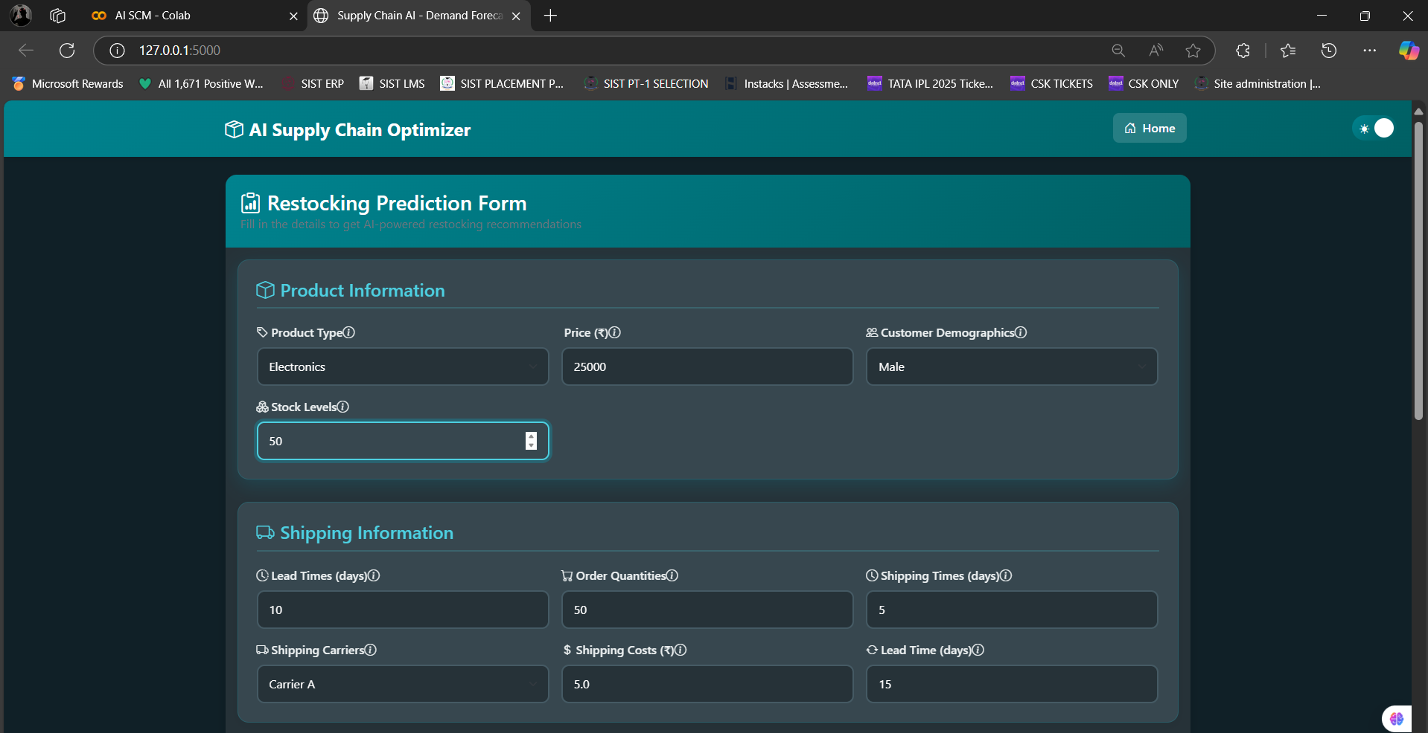
RESULTS SNAPSHOTS

Slide 16
REFERENCES
1. Ivanov, D., & Dolgui, A. A digital supply chain twin for managing the disruption risks and resilience in the era of Industry 4.0. International Journal of Production Research, 2020, 58(12), pp. 4090–4102.
2. Brown, R., & Zhang, Y. Predictive Analytics in Supply Chain Management Using LSTM Neural Networks. Journal of Artificial Intelligence and Data Science, 2022, 5(1), pp. 33–45.
3. Chollet, F. Deep Learning with Python. Manning Publications, 2018.
4.Hochreiter, S., & Schmidhuber, J. Long Short-Term Memory. Neural Computation, 1997, 9(8), pp. 1735–1780.
5. Flask Documentation Team. Flask Documentation. Available online: https://flask.palletsprojects.com/
6. Ghosh, A., & Roy, D. Integration of AI Models in Supply Chain Analytics. Journal of Supply Chain Management, 2020, 12(4), pp. 211–228.
7. Srivastava, A., & Sharma, R. Using Flask Framework for Machine Learning Web Apps: A Practical Approach. Journal of Web Applications and Tools, 2022, 8(2), pp. 77–89.

Slide 17

AI SUPPLY CHAIN MANAGEMENT

